Slide 1
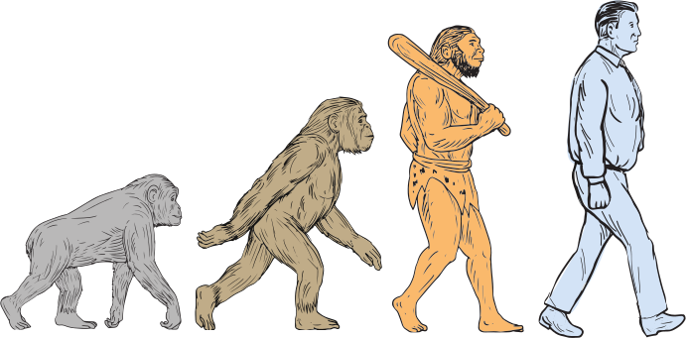
Behavioural Economics
2.4
Copyright Chandler Bell

Slide 2
Homo Economicus
"Standing alone, with money in his hand, ego in his heart, a calculator in his head and nature at his feet. He hates work, he loves luxury and he knows the price of everything."
Source: " Kate Raworth "
Neoclassical Theory
The assumption that human behaviour is completely rational and utility-maximising . Are humans really like this?
Copyright Chandler Bell

Slide 3
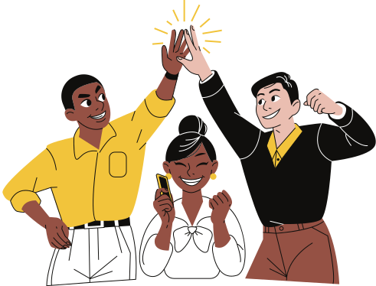
Not Exactly
There is a lot of evidence suggesting that humans are not as rational as economic theory and models suggest.
We are ...
Compassionate
Collaborative
Complex
Copyright Chandler Bell

Slide 4
Video
Copyright Chandler Bell

Slide 5
Question
Which Phone should I buy? Homo Economicus will:
•Know exactly what she wants from her phone.
•Research the capabilities of all the different phones.
•Understand all the information that is provided.
•Be able to compare all the models.
•Know the prices of every phone on the market.
•Know how long each phone will last.
•Know what she will need from her phone in two years.
•Be able to know which phone makes her happiest.
Discuss
How realistic is each of those expectations? What problems would Homo Economicus face?
Copyright Chandler Bell

Slide 6
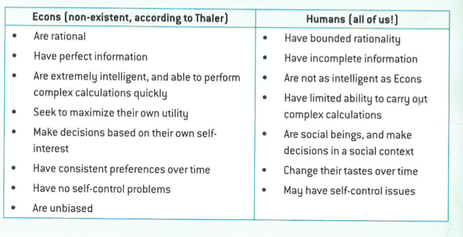
Behavioural Economics
FOUNDED BY RICHARD THALER
Copyright Chandler Bell

Slide 7
Video
Copyright Chandler Bell

Slide 8
Inquiry
Behavioral Economics Theory
Copyright Chandler Bell

Slide 9
Inquiry Document

Slide 10
Enjoying The Content?
Visit bananaomics.com to purchase package deals with discount prices!
BANANAOMICS

